Slide 1
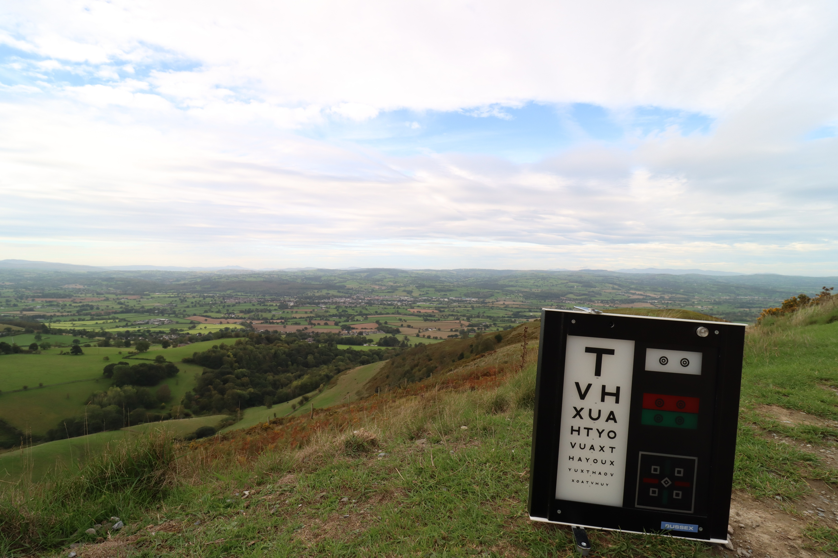

Ready to Act
Enabling sustainable Optometry in Wales

Slide 2
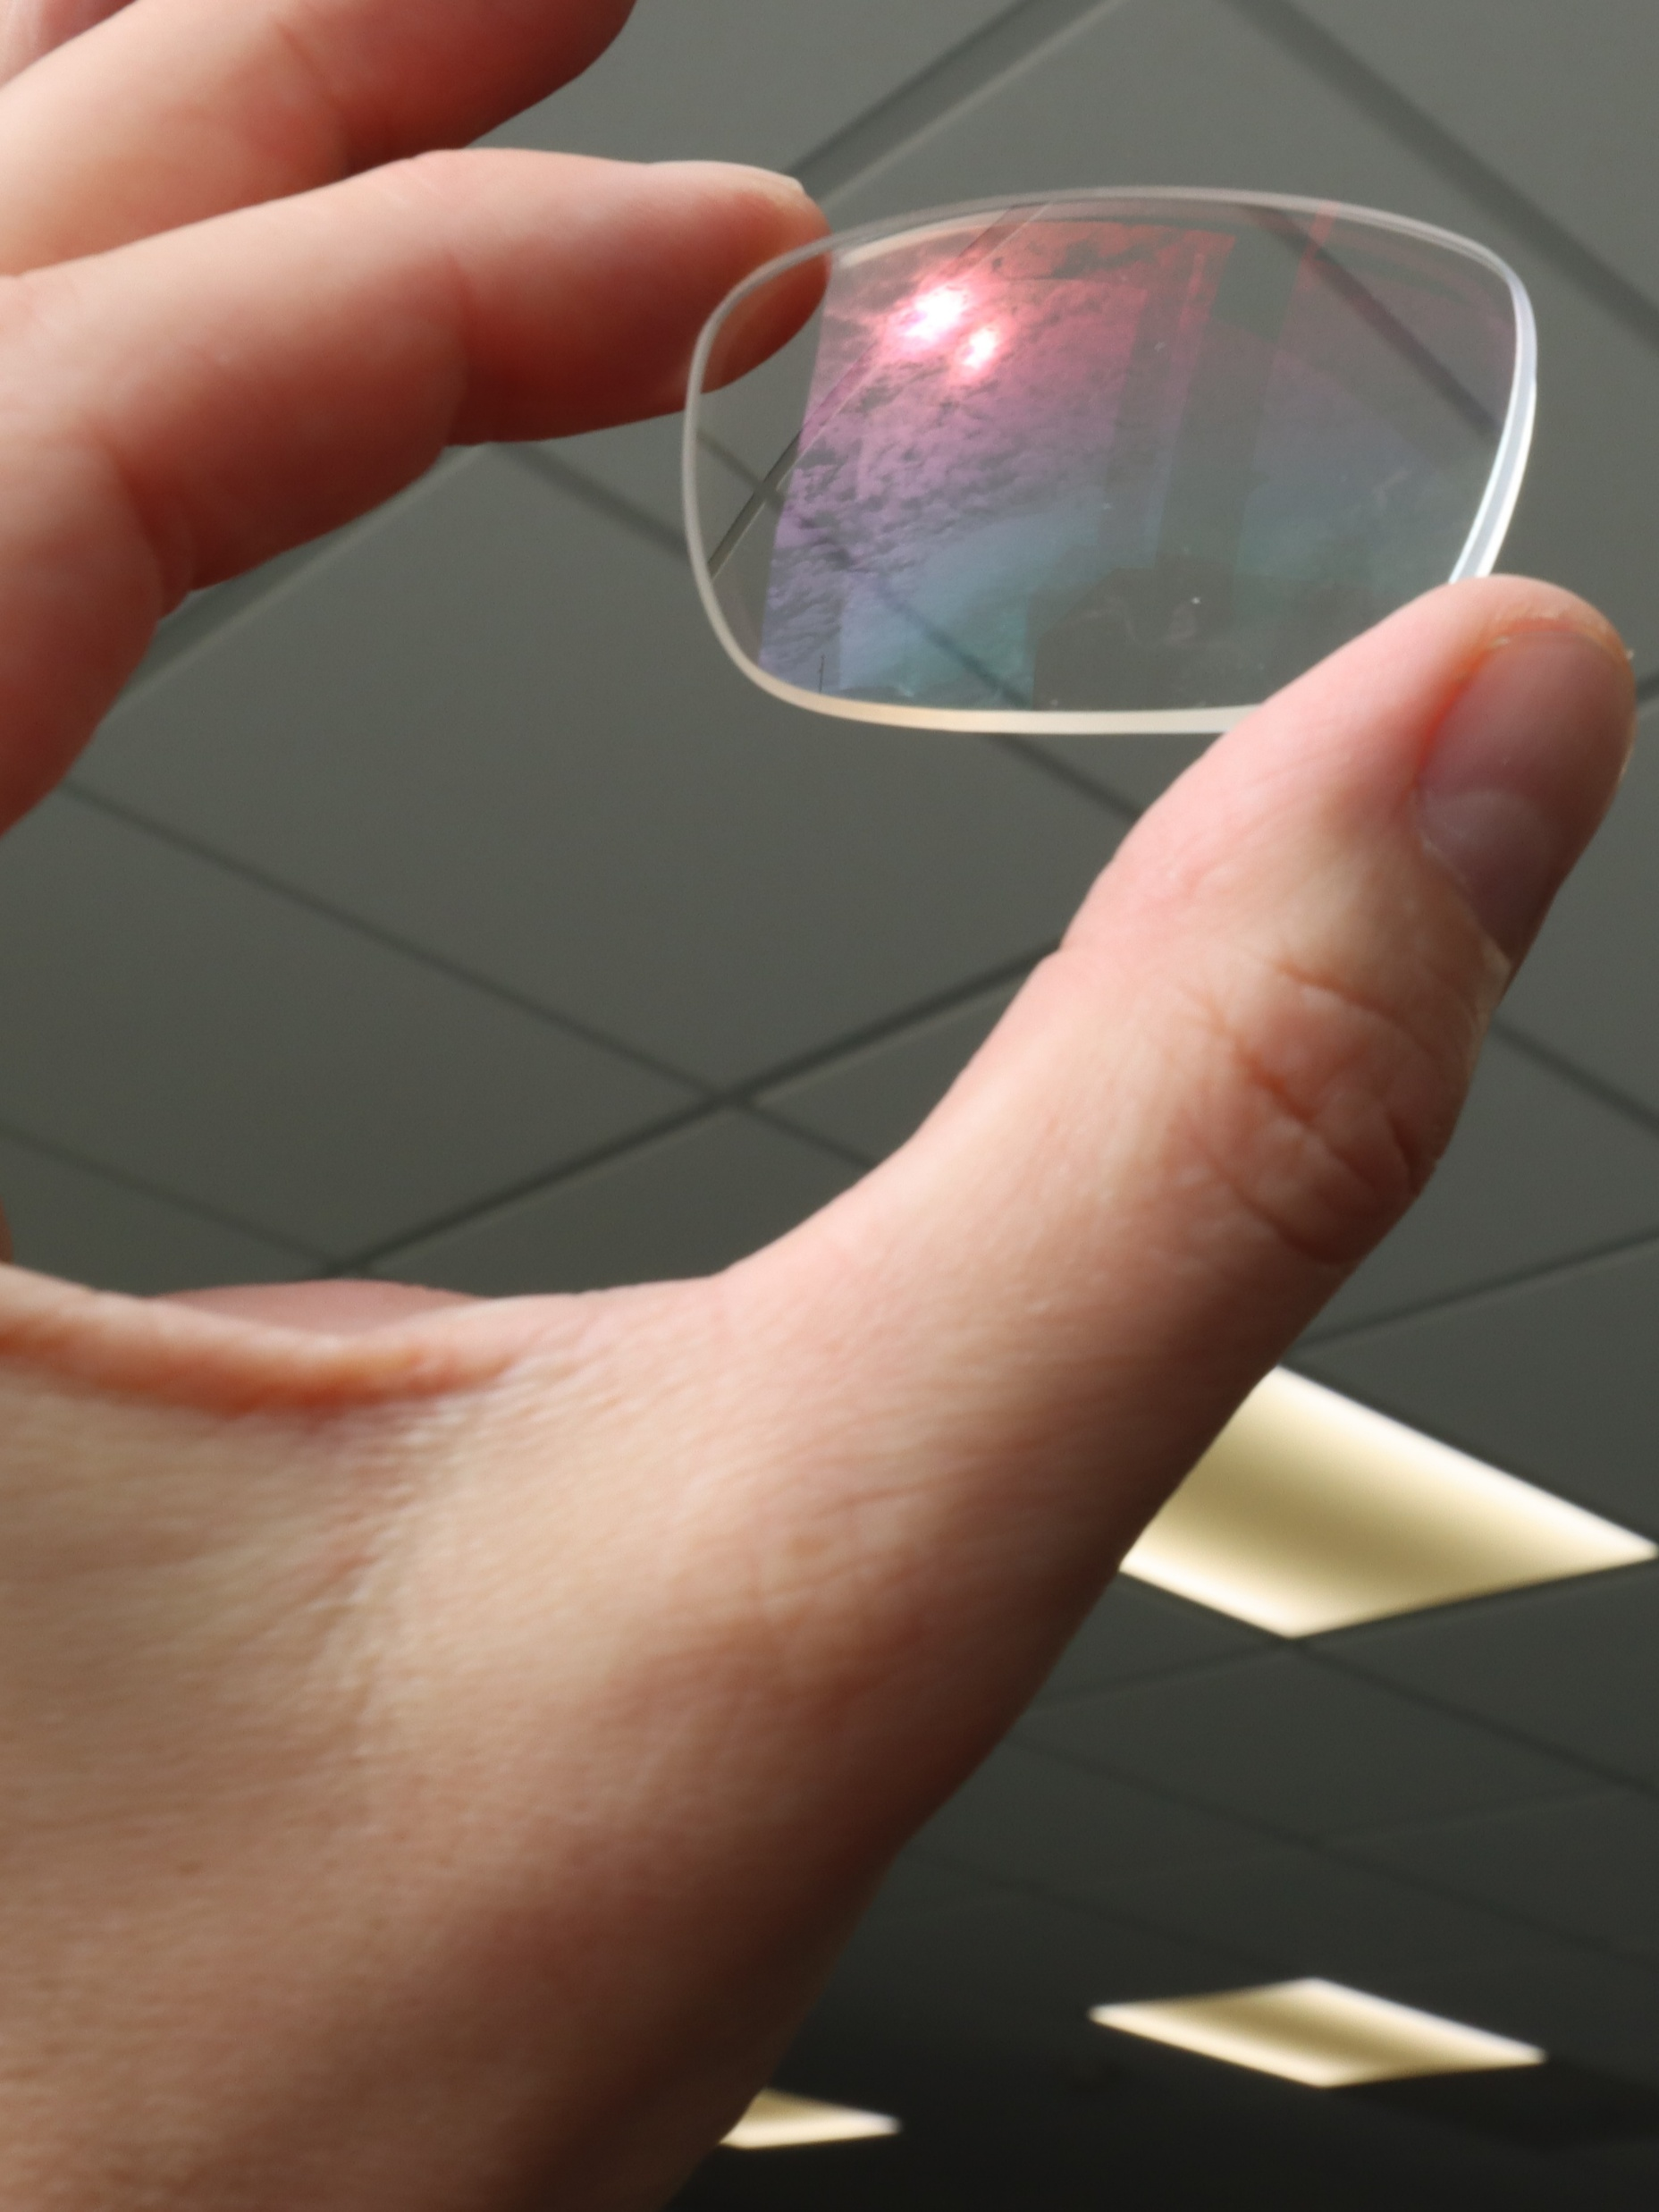
Overview:
Foreword
Executive Summary
Key Findings
Recommendations

Slide 3
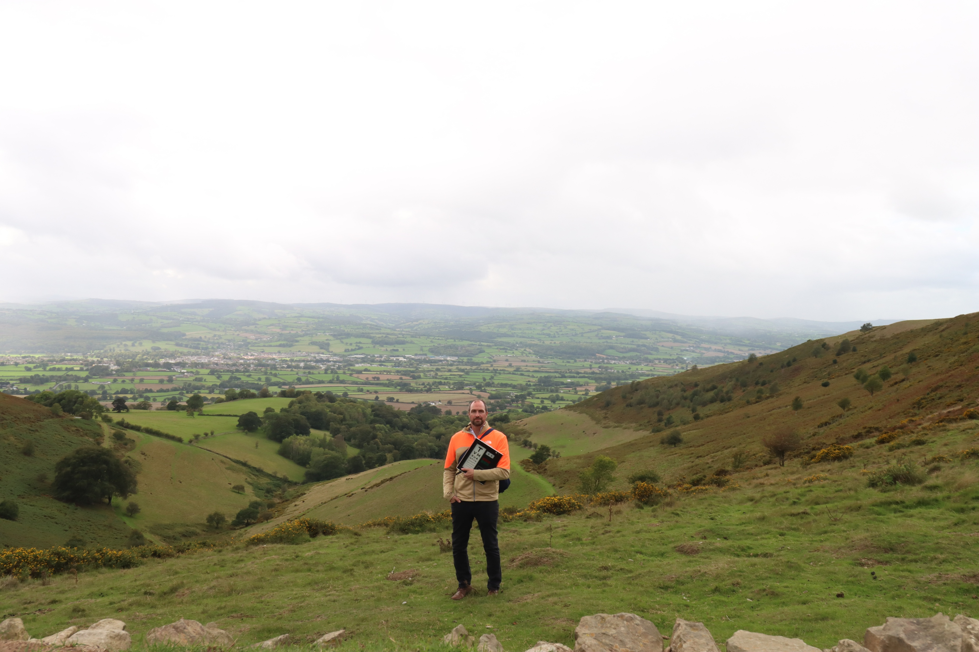

Slide 4
Finding 1
Environmental sustainability is recognised as a legitimate concern within the Optometry profession in Wales.
Finding 2
The profession reports a substantial foundation of capability and motivation upon which further progress may be built.
Finding 3
Opportunity appears to represent the most significant constraint upon pro-environmental behaviours.
Finding 4
Awareness and understanding influence perceived responsibility and engagement.
Finding 5
Supportive interventions are consistently preferred to punitive interventions.
Finding 6
Education, Incentivisation, Training and Enablement appear most likely to facilitate adoption of sustainable behaviours.
Finding 7
Agency to influence change, in the immediate term, sits with Welsh Government, NHS Wales, and Health Boards (via legislation, guidance, and fiscal measures).
Finding 8
Agency to influence change, over the longer term, sits with every organisation and every individual.
Finding 9
The Linear Model provides a practical framework through which effort may be prioritised and targeted.

Slide 5
Recommendation 1
Adopt the Linear Model as a practical framework for directing sustainability activity within Welsh Optometry.
Recommendation 2
Prioritise interventions and system developments which enhance opportunity for pro-environmental behaviour.
Recommendation 3
Expand education and training relating to environmental sustainability across the profession.
Recommendation 4
Use incentives and supportive mechanisms to encourage participation and innovation.
Recommendation 5
Actively seek to create a culture whereby pro-environmental behaviours are expected, giving mandate to the profession.
Recommendation 6
Increase awareness of relevant legislation and policy commitments in Wales.
Recommendation 7
Strengthen collaboration and feedback between practitioners, practices, Health Boards and policymakers.
Recommendation 8
Recognise societal purpose as vital as clinical purpose via a professional pledge.
Recommendation 9
Undertake a repeat assessment within three to five years to evaluate progress and refine future priorities.

Slide 6
Conclusion 1
Sustainability is viewed as legitimate
Conclusion 2
Sustainability aligns with professional identity
Conclusion 3
Clinical Purpose and Societal Purpose are complementary
Conclusion 4
The foundations for progress already exist
Conclusion 5
Influence is concentrated, responsibility is shared
Conclusion 6
Awareness influences responsibility
Conclusion 7
Opportunity constrains behaviour
Conclusion 8
Support is more effective than coercion
Conclusion 9
Systems matter

Slide 7
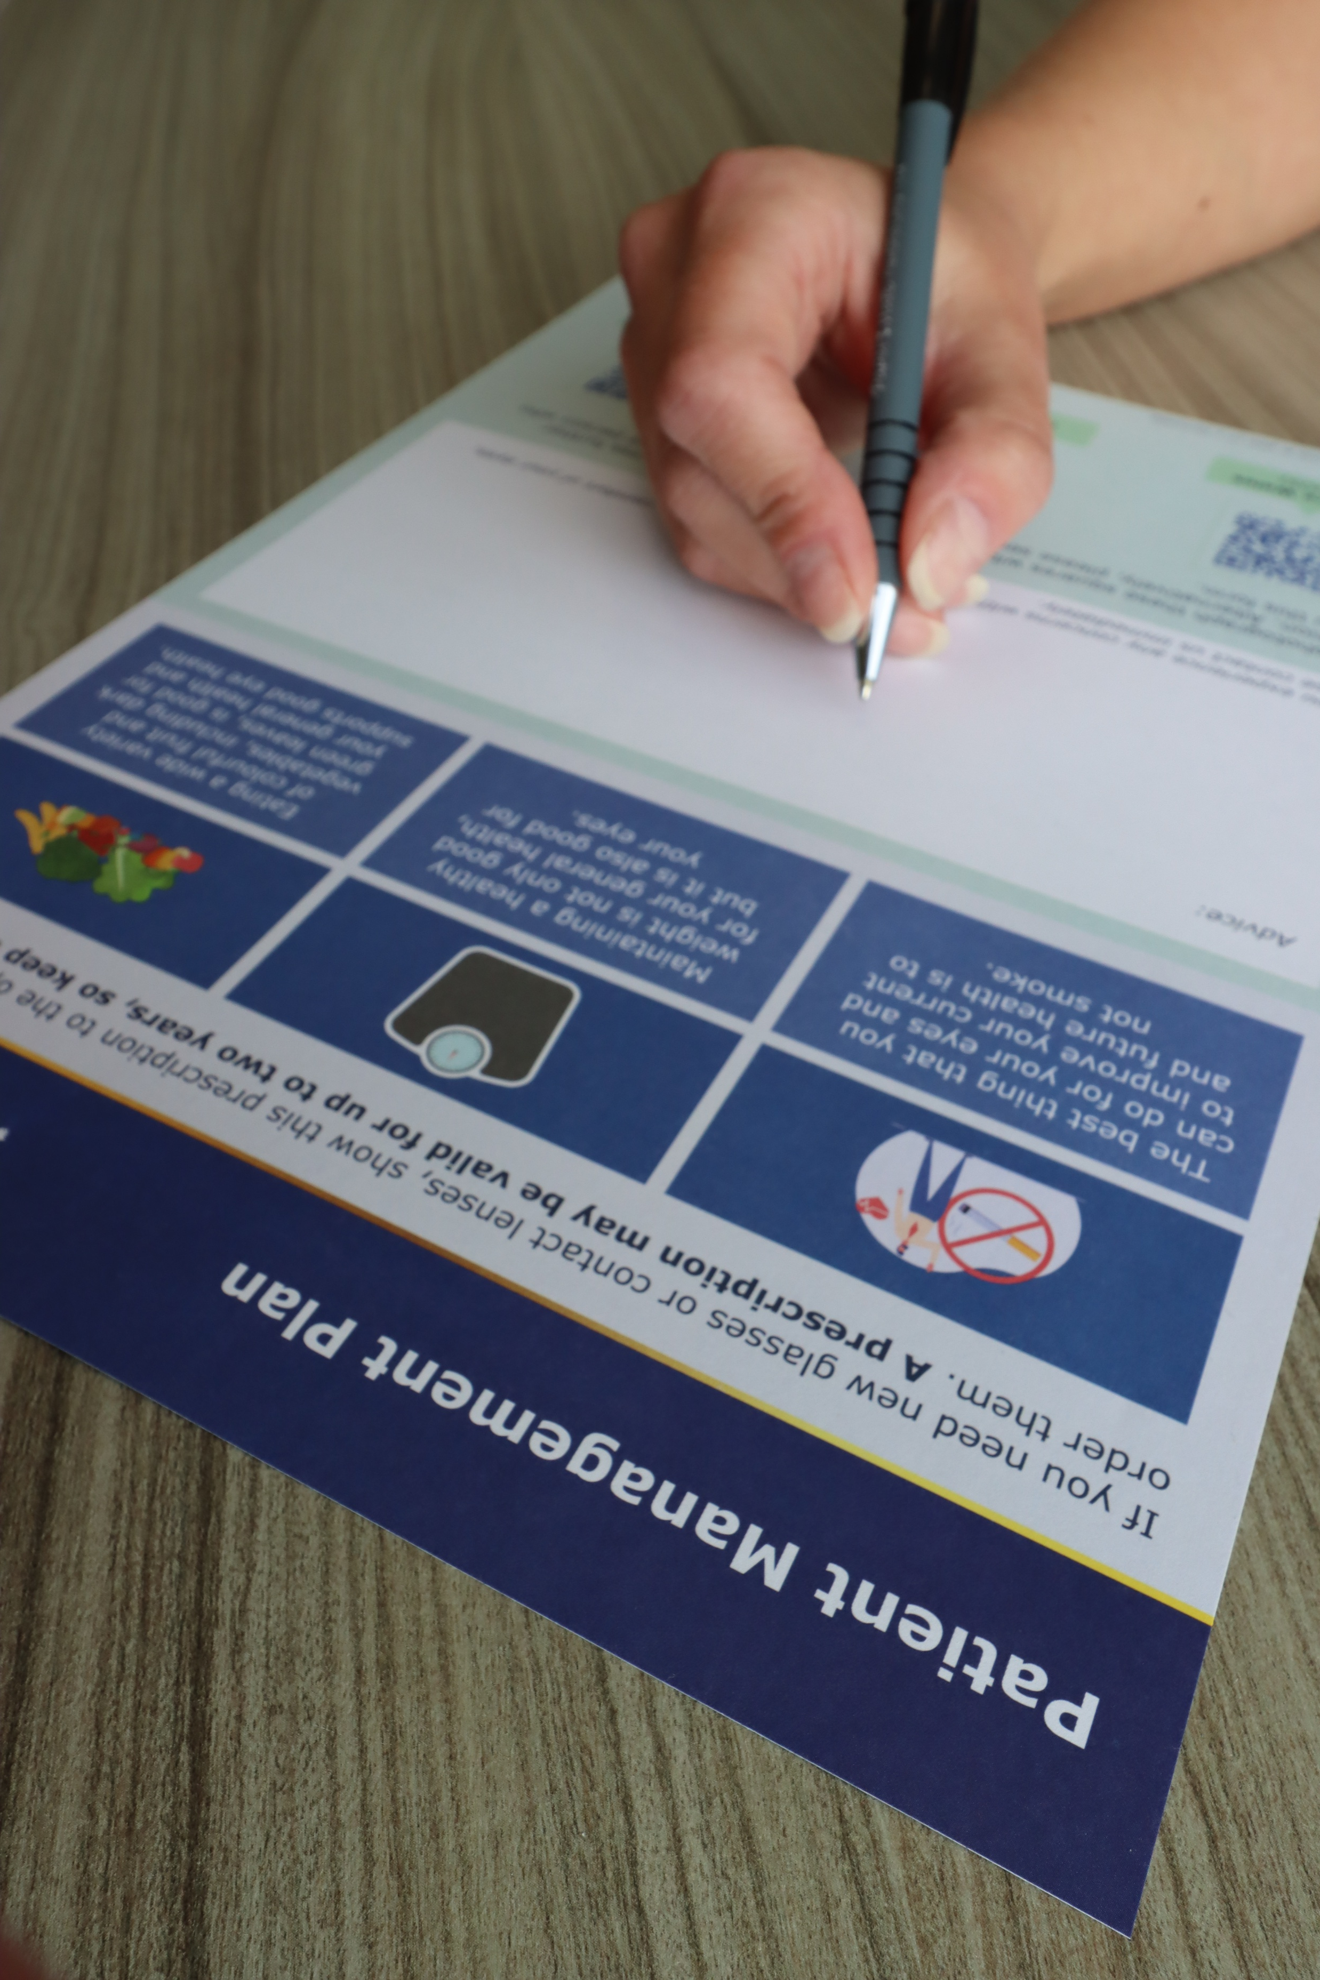
Justification:
Why Sustainability?
Why Wales?
Why Optometry?

Slide 8
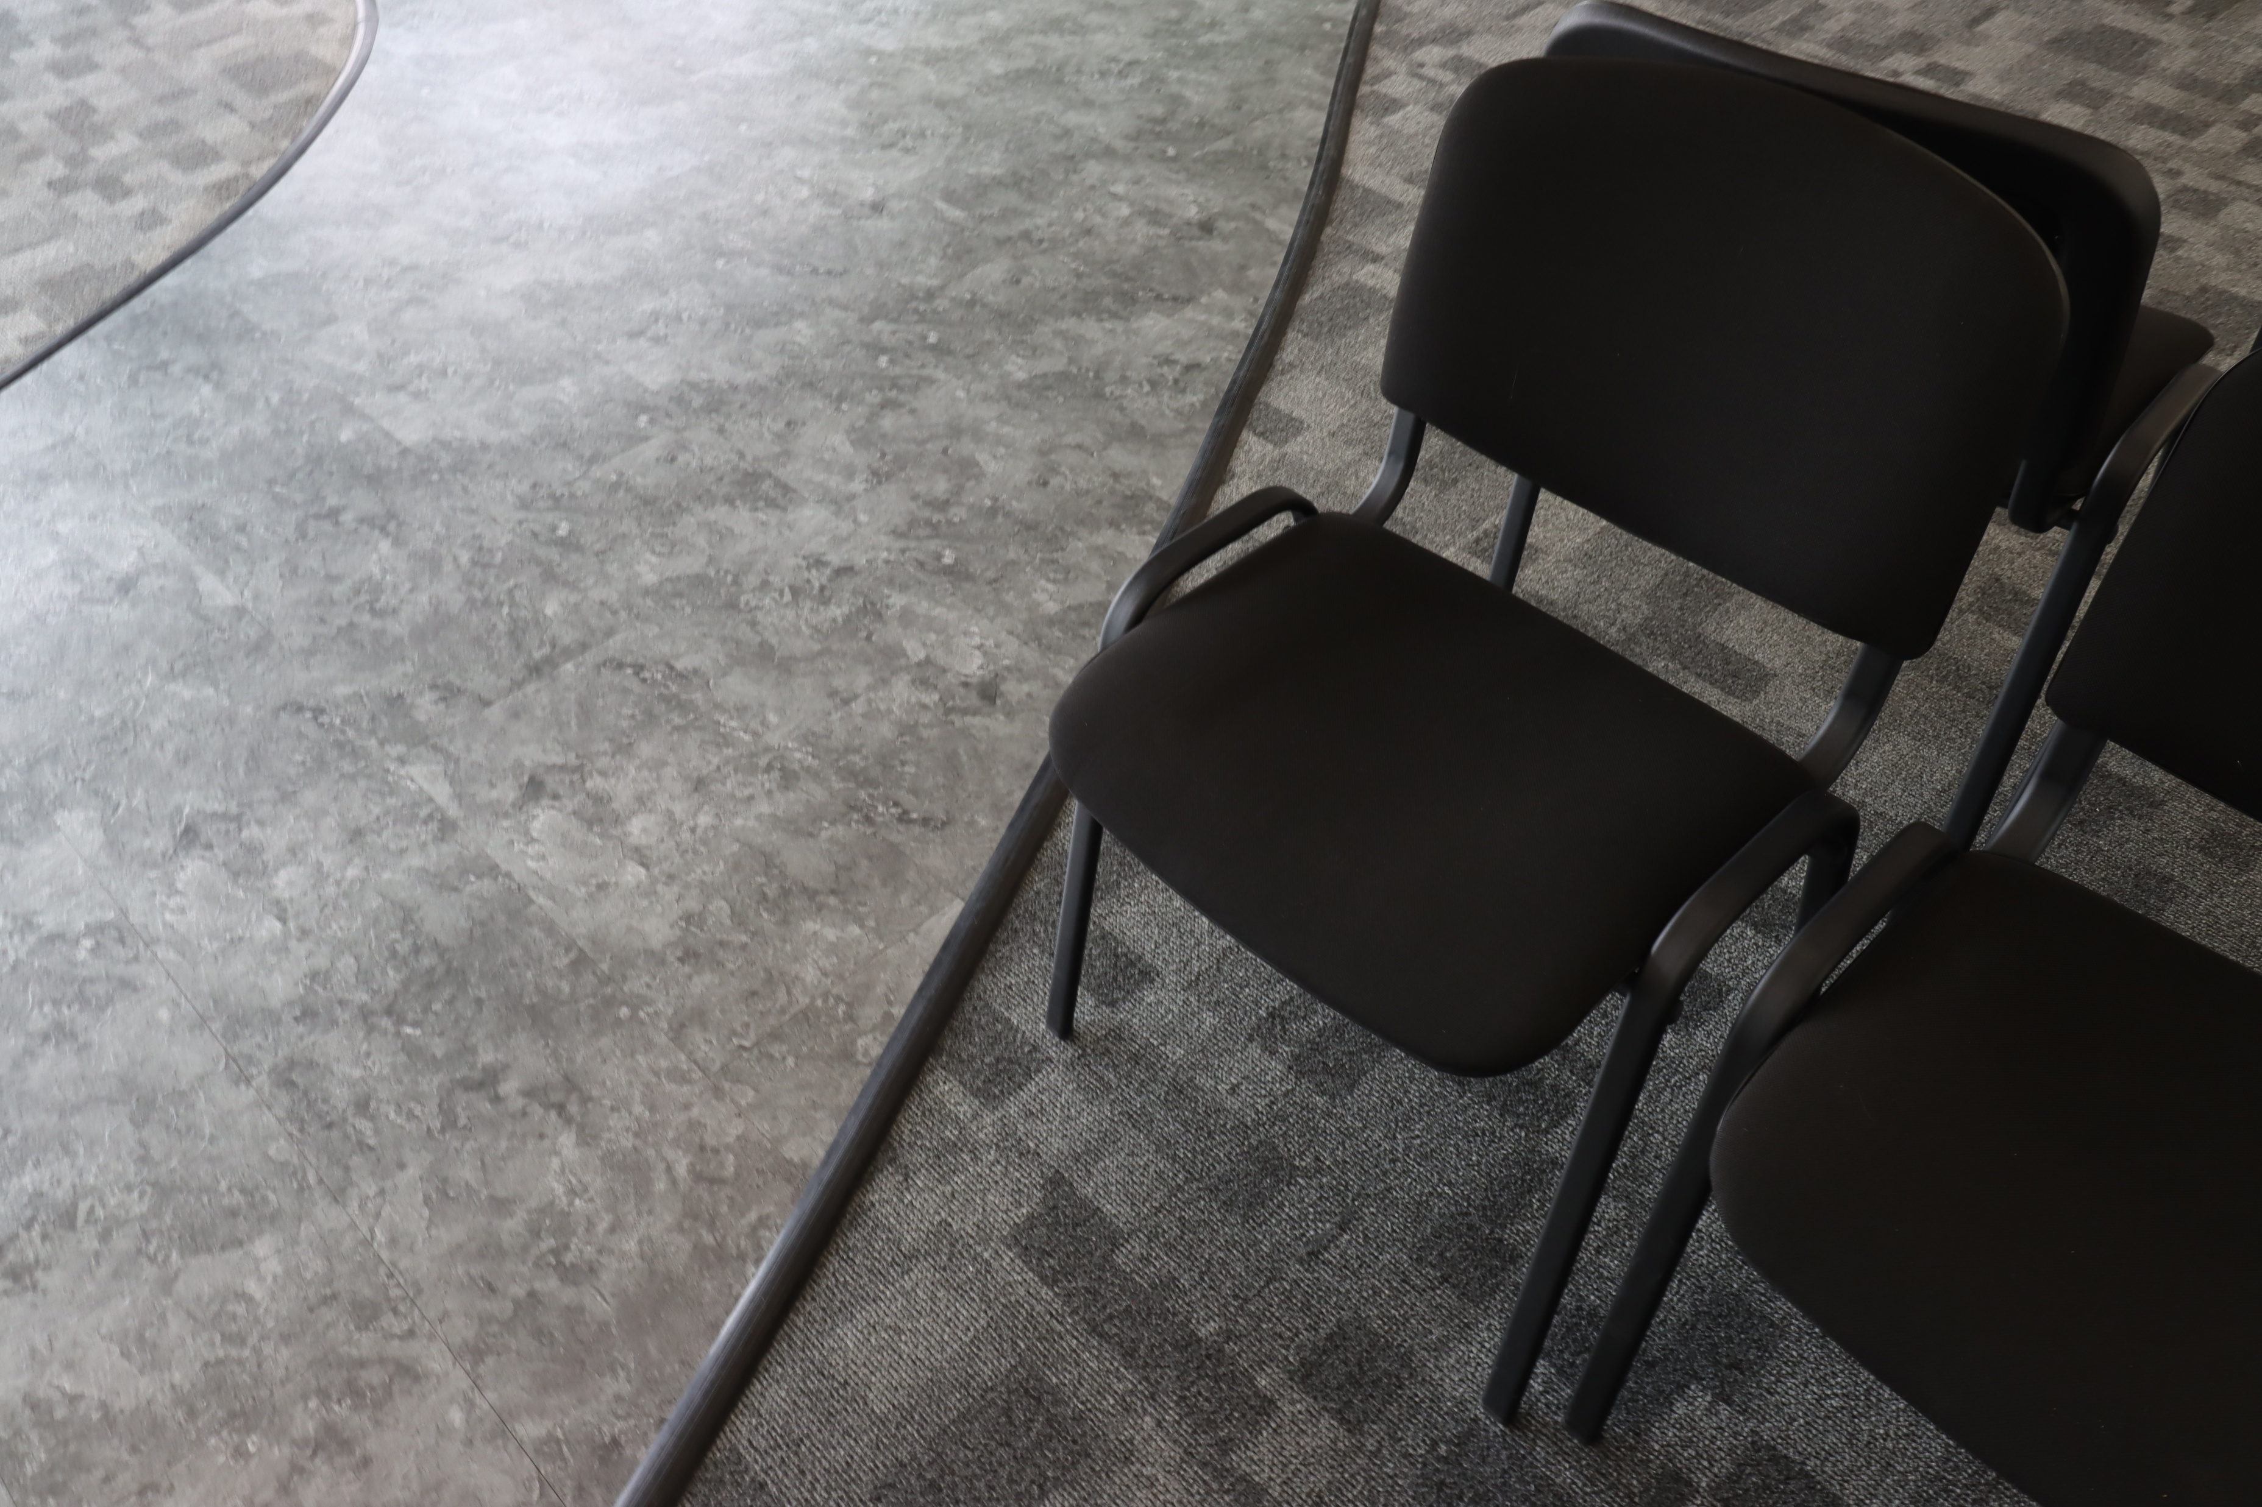
The informing studies:
The questions explored
Conceptual foundations
The study’s methods
Conclusions

Slide 9
Phase One
Pro Environmental Behaviours expressed by awareness, views, capability, opportunity and motivation.
Phase Two
Understanding the impact of interventions
Phase Three
Exploring influence across the whole system
Phase Four
Integration of understandings across entire programme
A pan-profession survey, n 1010.
Exemplar practices, Delphi Study and qualitative analysis
NHS Wales leaders Interpretive Structural Modelling
Narrative understandings and The Linear Model of Behaviours and Contextual Influences

Slide 10

Implications:
A framework for action
Looking ahead
Closing reflection

Slide 11
For practitioners,
For system leaders,
For policymakers,
it means prioritising interventions within system design capable of improving opportunities.
it means recognising that legislative and regulatory mechanisms influence behaviours and set culture.
For practices,
it means embedding sustainability within routine processes.
it means focusing upon behaviours most amenable to support.

Slide 12

Postscript:
Acknowledgements
Appendix
References

