Slide 1


An Introduction into Social Prescribing

Slide 2
Objectives
The lecture will cover:
The concept of social prescribing
The methods for social prescribing
The importance of social prescribers
The types of social prescribing
The benefits of social prescribing
Compassionate leadership in practice
Notes:
The purpose of this lecture is to introduce the idea of social prescribing and how this may work in an optometric setting.

Slide 3
What is social prescribing?
The definition of social prescribing:
‘connecting citizens to community support, to better manage their health and well-being’
Source: Rees et al (2019)
Notes:
So what is Social Prescribing? Social prescribing has been described as a method of ‘….’

Slide 4
What is social prescribing?
A non medical prescription
Person Centred
Holistic
Empowering
Collaborative
Beneficial to those with a variety of health conditions
Notes:
In addition, social prescribing can also be described as:
A non medical prescription that can be instigated alongside medical treatment
Person centred – this ensures the person is included in the decision making and all actions are relevant to the persons wants and needs.
Holistic – Rather than just addressing one area of need, holistic care refers to the provision of care based on a persons physical, psychological, emotional and spiritual needs.
Empowering – Individuals are supported to take greater control of their own health and well being.
Collaborative – Individuals and organisations like the NHS and local authorities as well as voluntary organisations and community groups work together to the benefit of the individual.
Beneficial to those with a variety of health conditions - Can benefit those with mild/long-term mental health problems, people with complex needs, people who are socially isolated and those with multiple long-term conditions.
Social prescribing is an intervention that appreciates that health and wellbeing are largely determined by a range of social, economic, and environmental factors and aims to support medical intervention.
Social prescribing provides a truly patient centred approach and enables patients to take greater control of their health and enables patient to focus on things that truly matter to them.
Social prescribing crosses all sectors, including health boards, local authorities, the voluntary sector and communities in a truly collaborative manner.
It has been shown to provide benefit to those with low level mental health problems, those who are socially isolated and those with a number of health conditions to improve both their mental physical well being.

Slide 5
NICE Guidelines
Primary and secondary care clinicians, managers and commissioners should collaborate to develop local care pathways….
Older people who are at risk of a decline in their independence and mental wellbeing are identified by service providers.
At every opportunity, ask people if they smoke and advise them to stop smoking in a way that is sensitive to their preferences and needs
Health and social care staff opportunistically carry out screening and brief interventions for hazardous and harmful drinking as an integral part of practice
Older people are asked about falls when they have routine assessments and reviews with health and social care practitioners, and if they present at hospital.
Adults have access to a publicly available, up-to-date list of local lifestyle weight management programmes.
Notes:
NICE provides guidance on ways health care professionals can improve the health and well being of the general population, as well as vulnerable and more marginalised groups.
Health care professionals are encouraged to ask about health and lifestyle choices routinely and opportunistically to improve health outcomes for the local population and ensure local programmes receive good uptake.
This slide includes a number of statements taken from NICE guidelines in an aim to improve patient health and well being.
Some of these statements describe
the importance of collaboration between care clinicians, managers and commissioners to develop local care pathways.
The importance of identification of those at risk of a decline in their independence and those at risk of falls, as well as identification of those who smoke and take part in hazardous and harmful drinking. Clinicians should be able to sign post those at risk to supportive services.

Slide 6
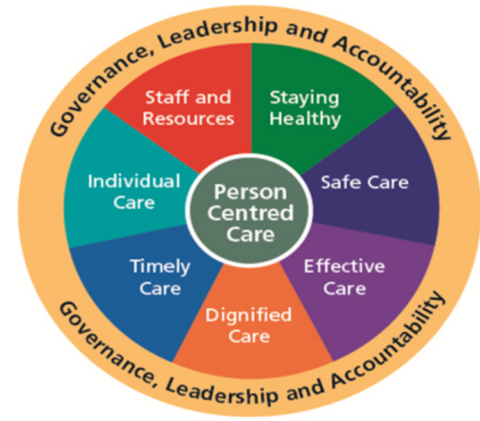
Person Centred Care
Source: NWSSP
Notes:
As mentioned previously, person centred care ensures the person is included in the decision making and all actions are relevant to the persons wants and needs.
As the image in the slide shows, there are many aspects to patient centred care, including care that is dignified, care that is effective and care that is timely. What is important for one individual, may not be important for another, so a conversation about what matters most to the person will help direct care in a way that is most effective for that individual.
Person centred care is at the very heart of social prescribing. Patients are invited to talk about what truly matters to them, and to agree on a plan that really works for them allowing them to take greater control over their own health and individualising their care.

Slide 7
Methods of Social Prescribing
Notes:
We will now move onto the methods of social prescribing.
There are a number of intervention and methods that fall under the social prescribing category which will be covered in the following slides.

Slide 8

Methods of social prescribing
Make Every Contact Count - ‘A light touch’
  For people who are confident to find their own way after signposting
Source: Cardiff and Vale UHB
Notes:
Make every contact count is a concept that aims to ensure each meeting with a HCP provides patients with the support they need to improve their health and well being, and that no opportunity is lost.
Make every contact count will feature in the requirements of the new Wales General Ophthalmic Services contract and appropriate training will be provided.
In short, make every contact count enables HCP to sign post to appropriate services where they feel a patient could benefit from an intervenation.
This may involve smoking cessation or nutritional advice amongst others.
Signposting is useful for those patients who are able to easily take on the advice of HCP and follow through on recommended actions. It should be noted that not all patients may be able to do this.

Slide 9
Methods of social prescribing
An individual can be referred to a different services in a number of ways
An individual can be referred to a social prescriber to discuss the needs of the patient
  Feedback mechanism
  Manages expectations
  Local Variations
Notes:
For those individuals who require more support, a referral to a service may be appropriate and a referral to a service, where available, can be instigated in a number of ways:
Via GP or other HCP
Via social worker or other part of statutory sector
Via self referral
Third sector
Targeted referral by social prescribers
Via social prescriber
In certain areas, a social prescriber may be referred to for organisation of social prescribing activity. When an individual is referred to a social prescriber, the social prescriber discusses with the patient what matters to them and formulates a plan for them to achieve their healthy living goals. This usually involves liaising with local support groups. The social prescriber maintains a relationship with the patient for an indeterminate period, enabling the patient to stay on track and provides a clear explanation of social prescribing to the patient to manage expectations. Feedback is provided from the social prescriber to the referrer.
Social Prescribers are vital to the success of social prescribing in many instances.
There are many different names for this role which you may come across, including Link Workers and Care Connectors.
Most social prescribers are paid, however there are instances where volunteers may also deliver this role.
There are variations in social prescribing services in each area. Some social prescribing services may only accept referral from GPs, GPs and HCP etc. Other may accept a self referral from the patient. It is important to be aware of these local variations which your local HB OA will be able to advise you on.

Slide 10
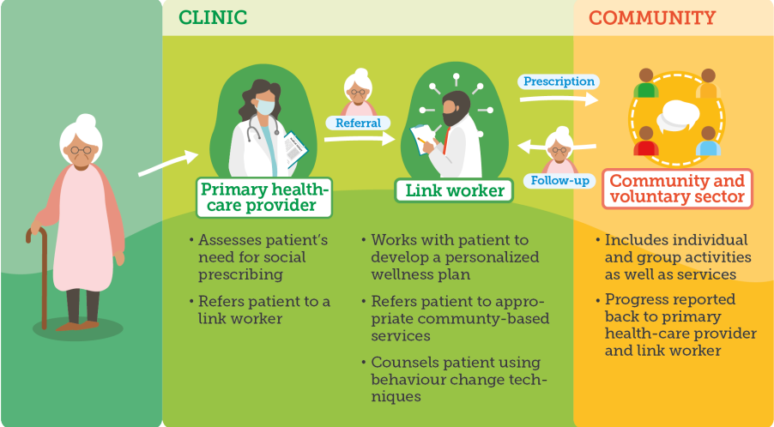
Source: WHO 2022
Notes:
This diagram demonstrates the pathway for social prescribing for those requiring greater support. The HCP determines the patients need for social prescribing and makes a referral to the local social prescriber.
The social prescriber develops a plan with the patient and refers the patient to local services and groups.
Progress is reported back to the social prescriber from the support services, and to the referrer.
In some instances HCP professionals may refer to services themselves, where a social prescriber is not available.

Slide 11
1. Sign Posting
Primary Care
Activity
Adapted from Source: Husk et al (2020)
2. Direct Referral from Primary Care
Primary Care
Activity
3. Social Prescriber
Primary Care
Social Prescriber
Activity
3+. Holistic
Primary Care
Social Prescriber
Activity
Notes:
This slide demonstrates the various methods of social prescribing, as previously described.
Sign posting involves direct sign posting to the activity and takes the least amount of time to implement as it involves the individual seeking out the activity.
Direct referral to an activity can also be provided from a primary care health care professional, providing a more direct approach to social prescribing.
Referral to an activity via a social prescriber, enables a more person centred approach, with activities discussed and directly relevant to the individual
A holistic approach to social prescribing, ensure a feedback mechanism is maintained from the activity to the social prescriber and to the referring clinician, closing the feedback loop and ensuring the individual is reaching their desired goals from the prescribed activity.

Slide 12
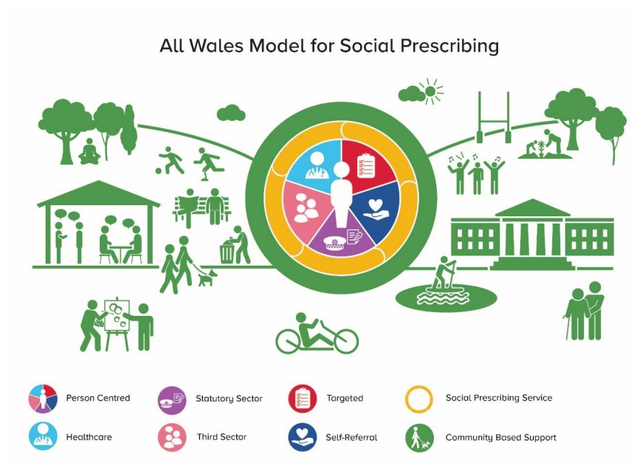
Source: Rees et al (2019)
Notes:
Again, this slide shows the social prescriber is key to linking up with support groups and ensuring the patient receives the support they require. The social prescriber liaises with a number of different services, within health care as well as third sector and community based support to ensure the person receives the support they require.
This diagram also highlights the individuals who can make a referral for social prescribing.

Slide 13
Types of social prescribing
Physical activity/exercise
Housing, welfare and financial
Adult education and literacy
Befriending
Counselling
Lunch clubs
Art and culture activities
Religious groups
Gardening
Cookery
Support Groups
Notes:
There are various types of social prescribing and this list is not exhaustive. The types of social will depend on the needs of the patient. Exercise can be great for those requiring increased physical activity, education may be needed for those who struggle with literacy. There are a wide range of services available.
Social prescribing is not just about prevention, it is just one avenue

Slide 14
Benefits of Social Prescribing
Improved quality of life
Improved mental health
Improved physical health
Reduction in use of NHS services
Notes:
Social prescribing has been shown to have benefits for the patients and for the health services.
Improved quality of life, improved mental and physical health and improved feelings of isolation have been found as a result of social prescribing (Holt-Lunstad, J et al 2010 and Chatterjee, H et al .
A reduction in attendance to secondary care, A+E and GP practices has also been found as a result of social prescribing, thereby providing additional benefits to the wider health services (Polley M (2017) et al).

Slide 15
Examples of Social Prescribing

Slide 16
Examples of social prescribing
Source: Social Prescriber SBUHB
Patient A
Patient A was 83 years old and hard of hearing.
Patient A was referred to:
Sensory Team in Council
Dance to Health, strength and balance classes for elderly
Virtual Ward
Fire service healthy homes check
Notes:
Patient A was 83 years old and hard of hearing. She lived alone and was recently bereaved of her husband of 14 years. Her daughter was caring for her but finding it difficult. Patient A felt she needed to improve her strength and balance to prevent her from falling.
Patient A was referred to:
Sensory Team in Council
Dance to Health, strength and balance classes for elderly
Virtual Ward
Fire service healthy homes check
Patient A received:
A Sensory Team appointment for Hearing Clinic to test equipment and for support.
Dance to Health classes offered but Patient A was unable to attend at this time.
A package of care from virtual ward.
Fitted fire alarms for hard of hearing from the fire service.
A virtual ward offers wrap around care, closer to home, allowing health care professionals to communicate more flexibly. Virtual wards help to support early discharge and prevent hospital admissions.

Slide 17
Source: Social Prescriber SBUHB
Patient B
Patient B had advanced dementia.
Patient B was referred to:
Warm Wales/ NEST for boiler and checks
Carers Centre for support, benefits check and sitting service
Notes:
Patient B had advanced dementia. She was nervous and housebound. Her family were caring for her in her home. Her son had given up work to care for her fulltime, and he was finding it hard and needed a sitter. Her son was not claiming carers allowance. The heating system was very old and not functioning properly.
Patient B received:
A new boiler and heating system through NEST
Online dementia support through Carers centre.
Carers allowance and up to £300 available for respite if needed
New hospital bed and equipment to make things easier at home.
‘Often you complain about things and no one hears, but in this instance many people have heard and a lot’s been done!’

Slide 18
Patient C
Patient C had a long history of anxiety and panic attacks resulting in dependency on medication.
Patient C was referred to:
Warm Wales
Tenancy Support Unit (TSU)
Happy Headwork Heads Up Programme
New Pathways
Source: Social Prescriber SBUHB
Notes:
Patient C had a long history of anxiety and panic attacks resulting in dependency on medication. As a result, Patient C didn’t go out much and had difficulties answering the phone. Patient C had been through a divorce and as a result had a difficult housing situation with a lack of finance. Patient C also had difficulties with her heating system as it was not functioning properly.
Patient C received:
Warm Wales - A new heating system from NEST, a CO2 monitor and was put on the Priority Service Register
Tenancy support unit provides housing related support and advice to home owners, those who rent, council tenants etc.
TSU referral resulted in weekly support from Caredig
Caredig is a non profit organisation providing housing and support in South West Wales.
Happy Headwork is an organisation that supports positive wellbeing
An online ‘Head’s Up Programme’ session and three one to one follow up sessions on the phone
New Pathways is a charitable organisation offering specialist crisis, advocacy, wellbeing and counselling services.
New Pathways referral has finally come through today and she will now be receiving weekly support

Slide 19
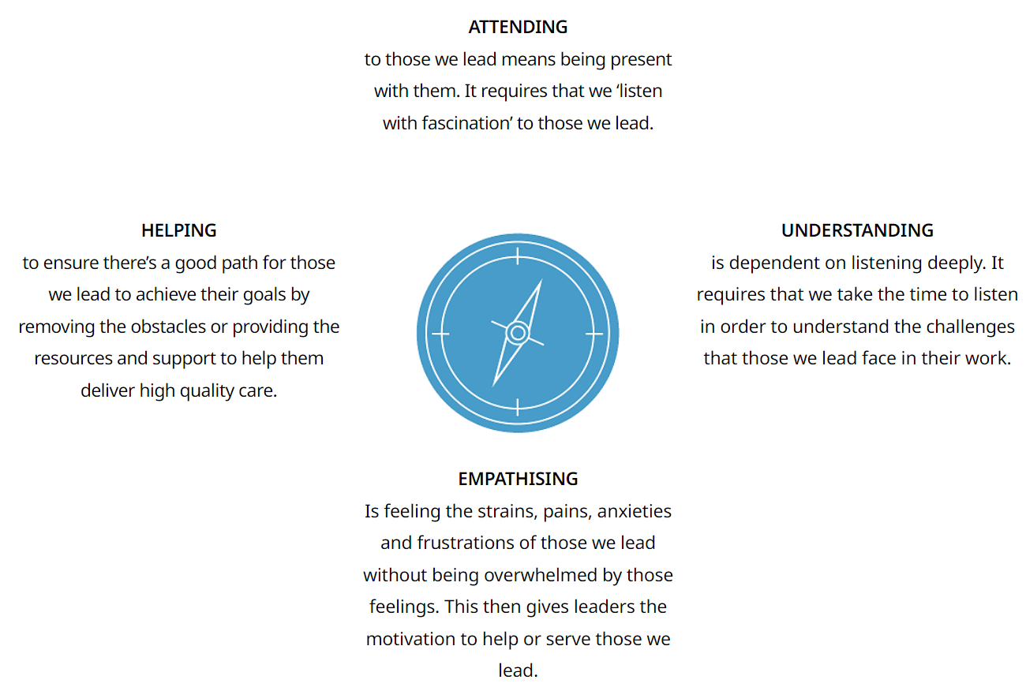
Compassionate leadership and social prescribing
Source: HEIW
Notes:
Compassionate leadership has shown to have benefits in the work place, reducing stress and having positive effects on work environment and productivity.
This slide shows the four principles of compassionate leadership: Attending, Understanding, Empathising, Helping
These four principles can be easily transferred to a patient setting enabling practitioners to compassionately lead their patients to a healthier well being,..
Attending: This means being present with those we lead and listening with fascination
Understanding: One should listen deeply to ensure we understand the challenges that people face
Empathising: Being able to feel the strains and anxieties of those we meet gives us motivation to help
Helping: By removing obstacles and providing support to those in need, we can support patients in acheieving their healthy well being goals

Slide 20

Source: Transformation Partners in Health and Care
Notes:
Please watch this short video which provides an overview of social prescribing. (If you double on the black screen it should start)

Slide 21
Summary
Social prescribing is a non medical intervention.
Sign posting is a low level method of social prescribing.
Social prescribers play a vital role in social prescribing.
Social prescribing can be instigated by a health care professional.
Social prescribing is person centred.
Social prescribing can include a number of various activities.
There are significant benefits to social prescribing.
Compassionate leadership can be used to benefit the well being of patients.
Notes:
So, just to summarise the points covered by this lecture:
Social prescribing aims to improve the well being of patients by using non medical interventions involving the community and voluntary sector. Patients are signposted or invited to take part in groups and activities that are likely to benefit them, addressing aspects of their well being that they may be struggling with.
Sign posting may a a suitable method of social prescribing for patients who have the confidence to action a recommendation from a HCP.
For others, a referral to a social prescriber may be more beneficial, as some patients may require more support to carry out recommendations that may benefit their well being.
Social prescribing is usually instigated by a HCP, however there are some instances where a patient may self refer to a social prescriber. Local variations do exist, and this should be checked prior to making a referral to a social prescriber.
And social prescribing harnesses person centered care, ensuring any referrals are made according to the needs and wants of that particular individual.
There are a variety of activities available to people who may need support to improve the health and well being and these will vary depending on the needs of the individual.
Social prescribing aims to improve the well being of an individual through improvements to social isolation, or physical wellbeing to name a few. However, there are also greater benefits to the community, including a reduction in attendance to primary and secondary health care as a result of improved well being, thereby improving access to health care for all.
By utilising the four principles of compassionate leadership, attending, understanding, empathising and helping, HCPs can compassionately lead patients to take on action to improve their health and well being.

Slide 22
Useful Resources
Home - Social Prescribing Network
What is social prescribing? | The King's Fund (kingsfund.org.uk)
The National Academy for Social Prescribing | NASP (socialprescribingacademy.org.uk)
Overview | Community engagement: improving health and wellbeing and reducing health inequalities | Guidance | NICE
Notes:
Theses are a list of useful resources that provide some background to social prescribing.

Slide 23
Diolch/Thank you

Slide 24
References
Bickerdike L, Booth A, Wilson PM, et al. (2017). Social prescribing: less rhetoric and more reality. A systematic review of the evidence. BMJ Open 2017;7:e013384. doi: 10.1136/bmjopen-2016-013384 Available at Social prescribing: less rhetoric and more reality. A systematic review of the evidence | BMJ Open
Chatterjee, H.J., Camic, P.M., Lockyer, B., and Thomson, L.J.M (2018) Non-clinical community interventions: a systematised review of social prescribing schemes, Arts & Health, 10:2, 97-123, DOI: 10.1080/17533015.2017.1334002. Available at Full article: Non-clinical community interventions: a systematised review of social prescribing schemes (tandfonline.com))
Gov.uk. Social Prescribing: applying All Our Health. Available at Making Every Contact Count (MECC) - Cardiff and Vale University Health Board (nhs.wales)
CVUHB. Making Every Contact Count (MECC). Available at Making Every Contact Count (MECC) - Cardiff and Vale University Health Board (nhs.wales)
Haslam C, Cruwys T, Haslam SA, Dingle G, Chang MX. Groups 4 Health: Evidence that a social-identity intervention that builds and strengthens social group membership improves mental health. J Affect Disord. 2016 Apr;194:188-95. doi: 10.1016/j.jad.2016.01.010. Epub 2016 Jan 21. PMID: 26828756. Available at Groups 4 Health: Evidence that a social-identity intervention that builds and strengthens social group membership improves mental health - PubMed (nih.gov)
HEIW. What are compassionate behaviours? Available at Interactive Compassionate Leadership Principles - What are Compassionate Behaviours? - Gwella HEIW Leadership Portal for Wales
Holt-Lunstad J, Smith TB, Layton JB. Social relationships and mortality risk: a meta-analytic review. PLoS Med. 2010 Jul 27;7(7):e1000316. doi: 10.1371/journal.pmed.1000316. PMID: 20668659; PMCID: PMC2910600. Available at Social Relationships and Mortality Risk: A Meta-analytic Review - PMC (nih.gov)
Husk K, Blockley K, Lovell R, Bethel A, Lang I, Byng R, Garside R. What approaches to social prescribing work, for whom, and in what circumstances? A realist review. Health Soc Care Community. 2020 Mar;28(2):309-324. doi: 10.1111/hsc.12839. Epub 2019 Sep 9. PMID: 31502314; PMCID: PMC7027770.
NHS England. Social Prescribing. Available at NHS England » Social prescribing

Slide 25
References Continued
Transformation Partner in Health and Care. Available at https://youtu.be/O9azfXNcqD8
NICE. Community engagement: improving health and wellbeing and reducing health inequalities. Available at Overview | Community engagement: improving health and wellbeing and reducing health inequalities | Guidance | NICE
NWSSP. Health and Care Standards with supporting guidance. Available at Health and Care Standards with supporting guidance - NHS Wales Shared Services Partnership
Polley, M., Bertotti, M., Kimberlee, R., Pilkington, K., and Refsum, C (2017). A review of the evidence assessing impact of social prescribing on healthcare demand and cost implications. Available at Microsoft Word - Polley et al Evidence summary of SP FINAL V3.docx (westminster.ac.uk)
Rees, S., Thomas, S., Wallace, C. and Elliott, M. (2019) Creating sustainable community assets/social capital within the context of social prescribing: Findings from the workshop held 17/07/19. Available at Creating sustainable community assets/social capital within the context of social prescribing (wsspr.wales)
Social Prescribing Network. Available at Home - Social Prescribing Network
The Kings Fund. (2020). What is social prescribing. Available at What is social prescribing? | The King's Fund (kingsfund.org.uk)
The National Academy for Social Prescribing. Available at The National Academy for Social Prescribing | NASP (socialprescribingacademy.org.uk)
WHO. (2022) A TOOLKIT ON HOW TO IMPLEMENT SOCIAL PRESCRIBING. Available at A toolkit on how to implement social prescribing (who.int)

